Slide 1
Advanced Directives---
EMS information
Stephanie Wagner
EMS Medical Director
Sacred Heart Hospital

Slide 2
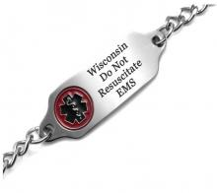

Objectives
DNR Orders
Wisconsin Chapter 154.17 statute
  Bracelets

Slide 3
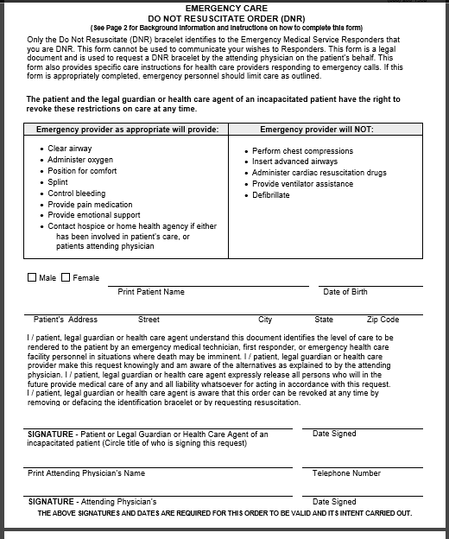


Slide 4
Following DNR orders
All emergency personnel will follow the DNR order if valid
If in question---CONTACT MEDICAL CONTROL DOC
Honor DNR bracelet UNLESS:
  Pt expresses desire to be resuscitated: REMOVE BRACELET
  Bracelet has been defaced by any means.
  Pt has moved bracelet
  Pt is known to be pregnant

Slide 5
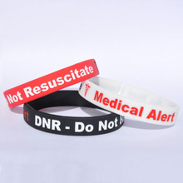
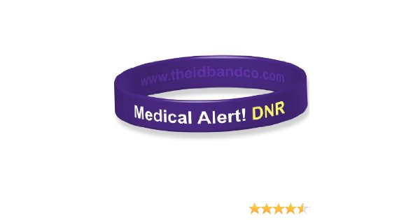
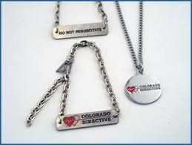
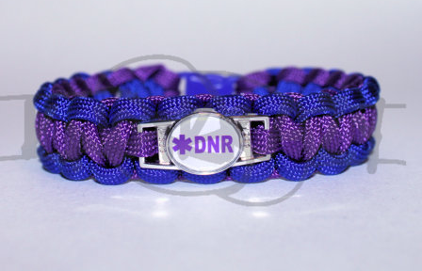
Notes:
These are all nonofficial jewelry/bracelets. Unless there is an official form to go with them you cannot follow them.

Slide 6
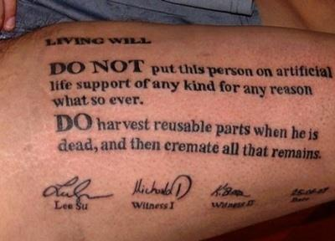

Slide 7

Procedures
Assess patient
If PNB, check for bracelet
If bracelet found and intact, provide COMFORT CARE MEASURES ONLY

Slide 8
Comfort Care
Examples—but not limited to:
  Oxygen
  Clearing airway and suctioning
  Controlling bleeding
  Comfort positioning and warming
  Provide emotional support
  Splinting
  Administering pain medication if licensed.

Slide 9
Other factors…
If a patients family member or friend requests that they want full resuscitation----DO NOT ACT on this request. DNR bracelets supersede families wishes.
Patient’s mental status has changed—contact Doc.
If in question—contact Doc.
Notes:
You may need to involve law enforcement if family gets challenging/hostile toward you. It is sometimes helpful to focus on the patient and say you are respecting their loved ones wishes. Its hard to argue with someone who is dead.

Slide 10

Violations
Any EMS personnel who does the following:
  Willfully conceals, defaces or damages the DNR bracelet WITHOUT consent of the patient.
  Withhold personal knowledge of the revoking of the bracelet.

Slide 11
Documentation
CYA
Take picture of the bracelet on patient if able to.
Get copies of all paperwork
Document
Sit down with partner and make sure all necessary paperwork has been filled out.

